Slide 1
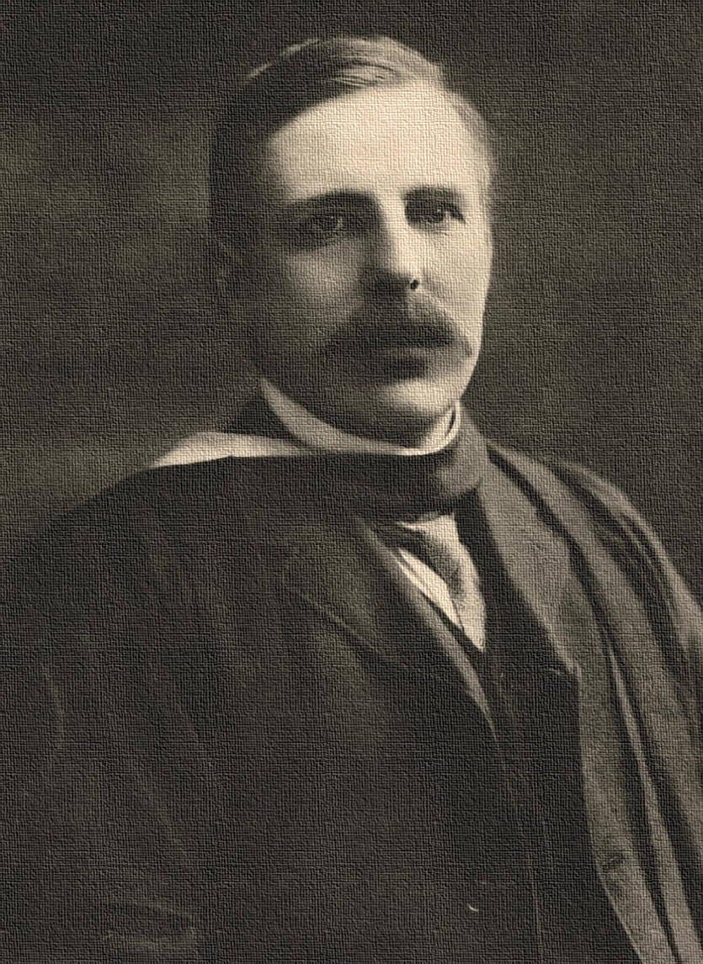

A Revolution Around the Life of Ernest Rutherford
Presentation in Chemistry

Slide 2
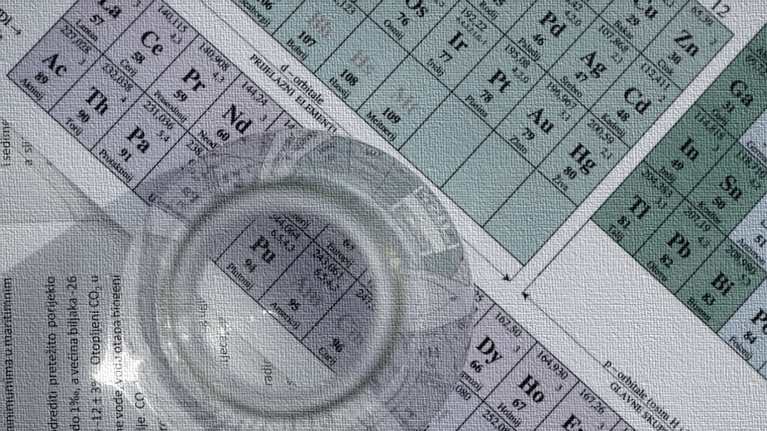
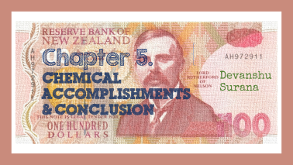

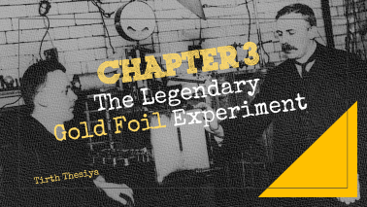



Contents

Slide 3

Chapter 1. Early Life and Education
Vedant Shirode

Slide 4

Birth
Ernest Rutherford (30 August 1871) was the son of James Rutherford, a farmer, and his wife Martha Thompson, originally from Hornchurch, Essex, England. James had emigrated to New Zealand. Ernest was born at Brightwater, near Nelson, New Zealand.

Slide 5
Educational Background
Ernest Rutherford attended the free state schools through 1886, when he won a scholarship to attend Nelson Collegiate School, a private secondary school.
Another scholarship took Rutherford in 1890 to Canterbury College in Christchurch, one of the four campuses of the University of New Zealand.
Rutherford's investigation of the ability of a high-frequency electrical discharge, such as that from a capacitor, to magnetize iron earned him a bachelor of science (B.S.) degree at the end of 1894.

Slide 6
During this period he fell in love with Mary Newton, the daughter of the woman in whose house he boarded.
He chose to continue his study at the Cavendish Laboratory of the University of Cambridge, which J.J. Thomson, Europe's leading expert on electromagnetic radiation, had taken over in 1884.

Slide 7
In 1898, Thomson recommended Rutherford for a position at McGill University in Montreal, Canada.
In 1901, Rutherford gained a DSc from the University of New Zealand. In 1907, he returned to Britain to take the chair of physics at the Victoria University of Manchester.

Slide 8
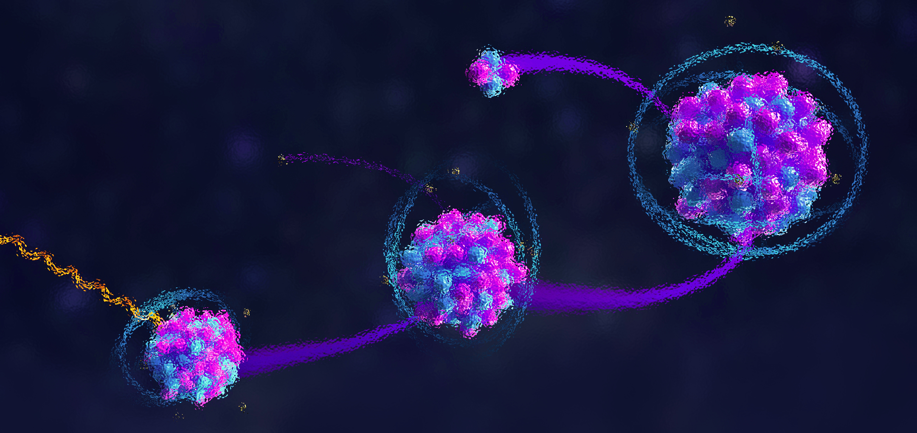

Chapter 2. The Story of Discovering Alpha and Beta Rays
KrishnarajThadesar

Slide 9
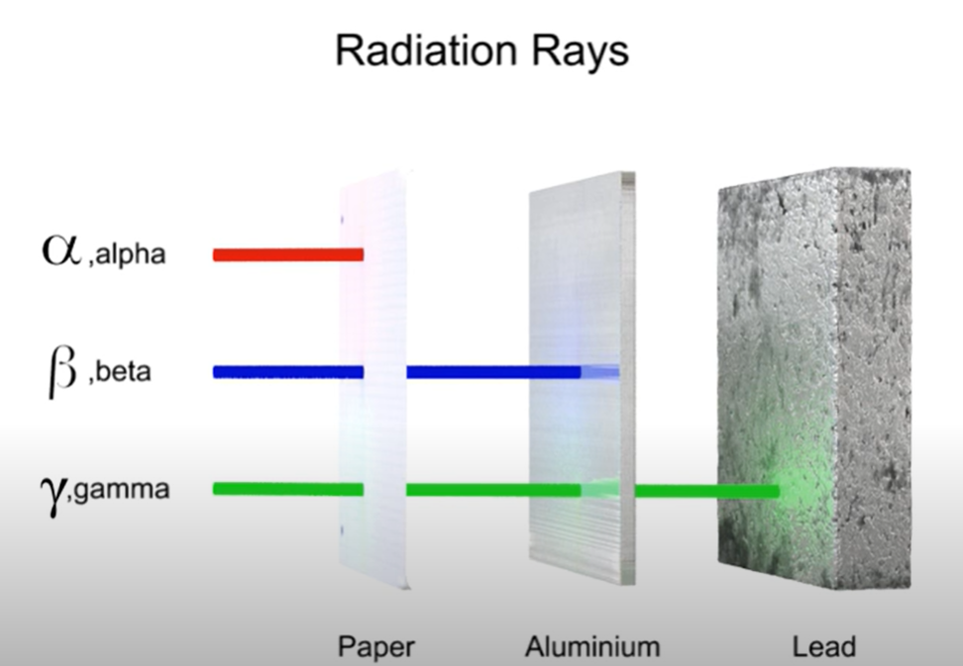

Slide 10
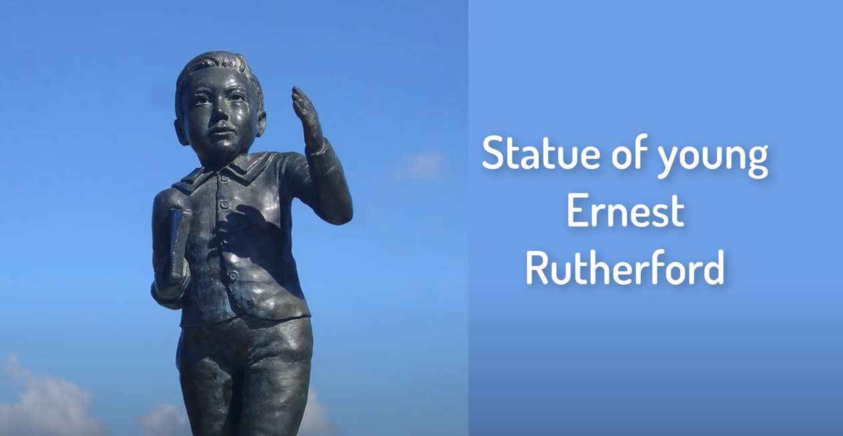

Slide 11
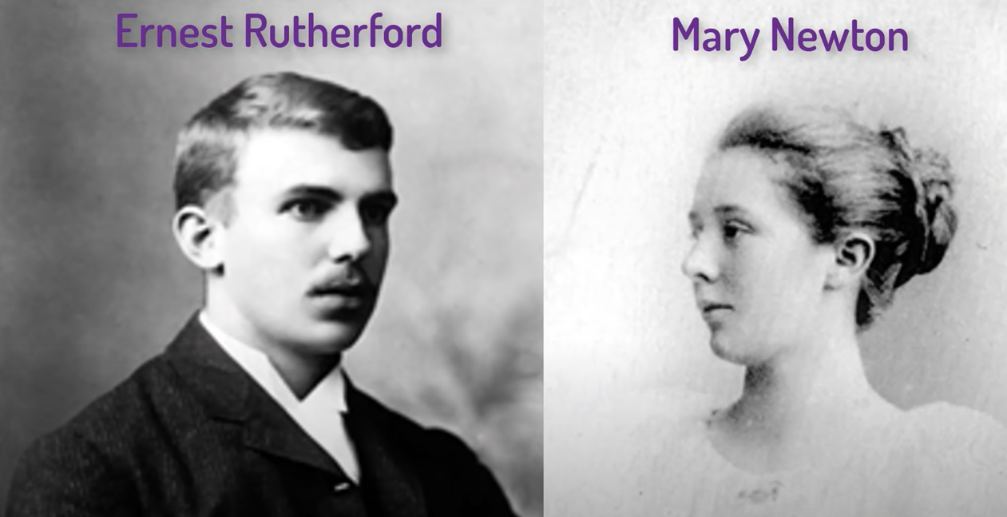

Slide 12
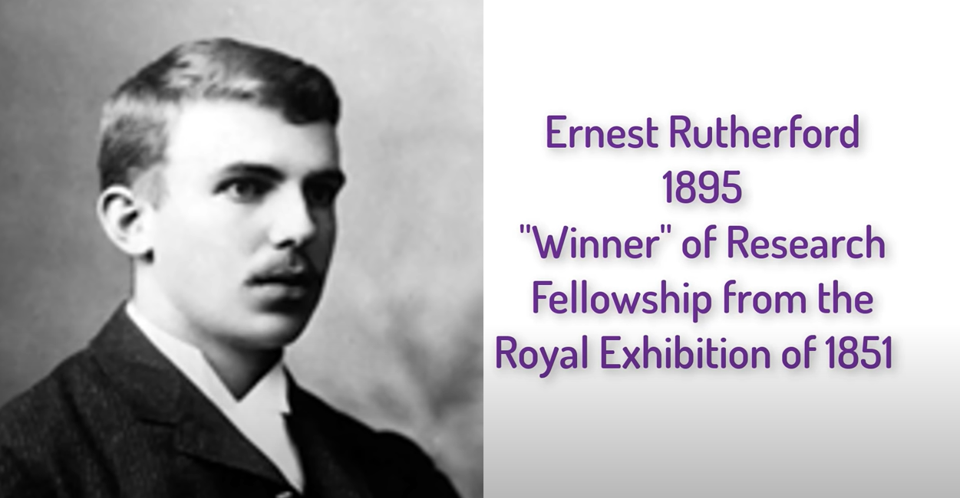

Slide 13
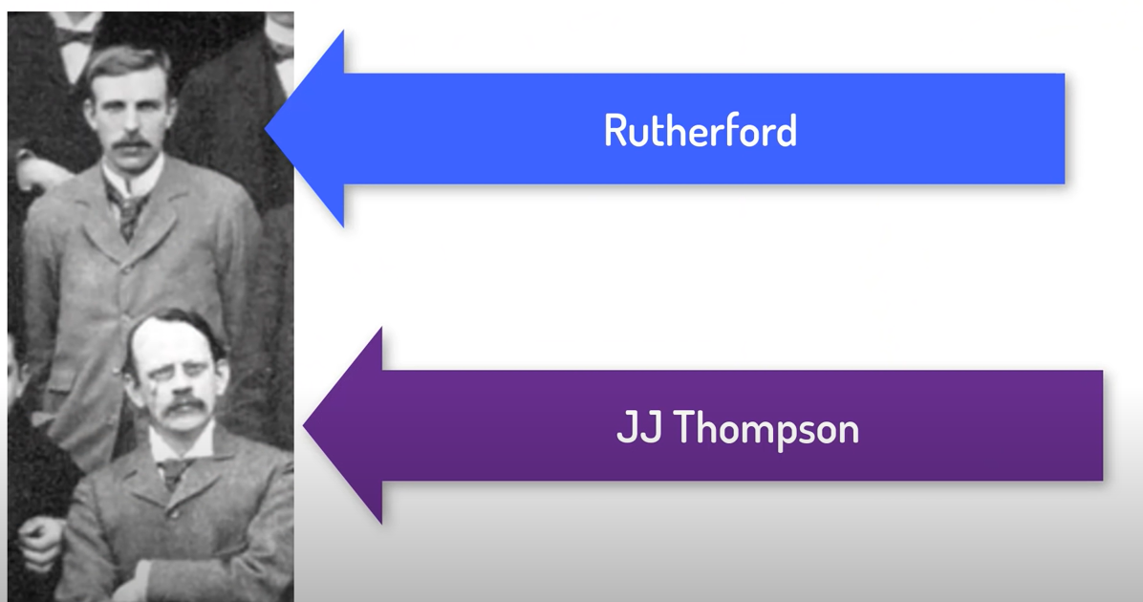
JJ Asks him to Do some Research on X Rays’s Effect on Gases

Slide 14
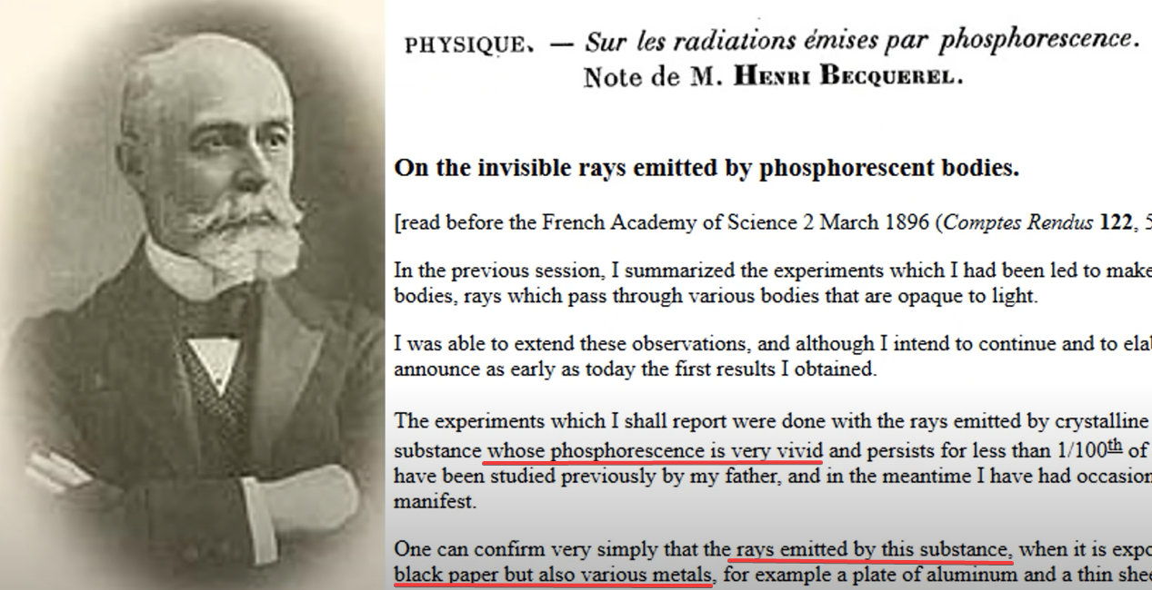

Slide 15
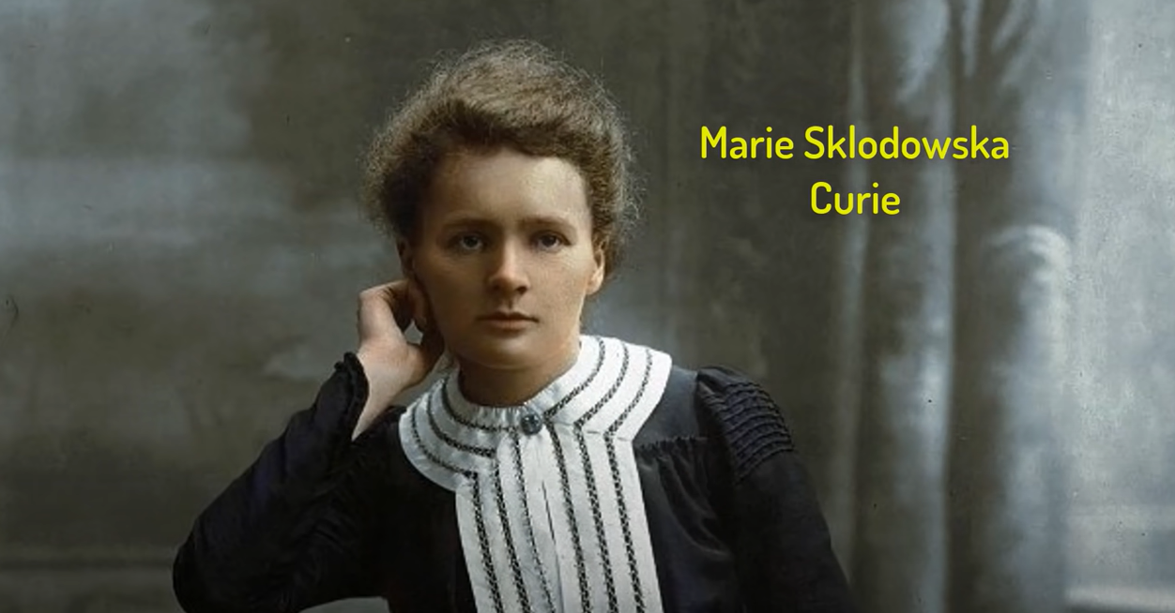

Slide 16
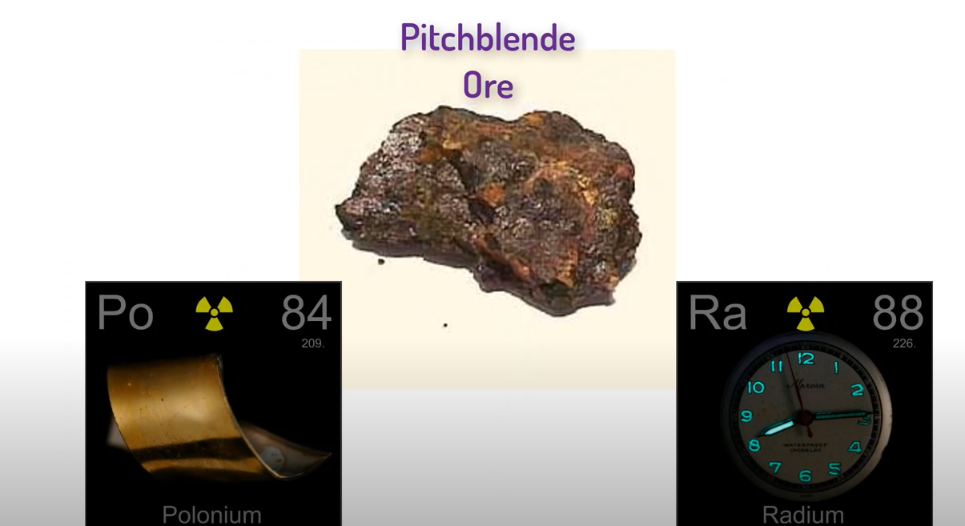

Slide 17
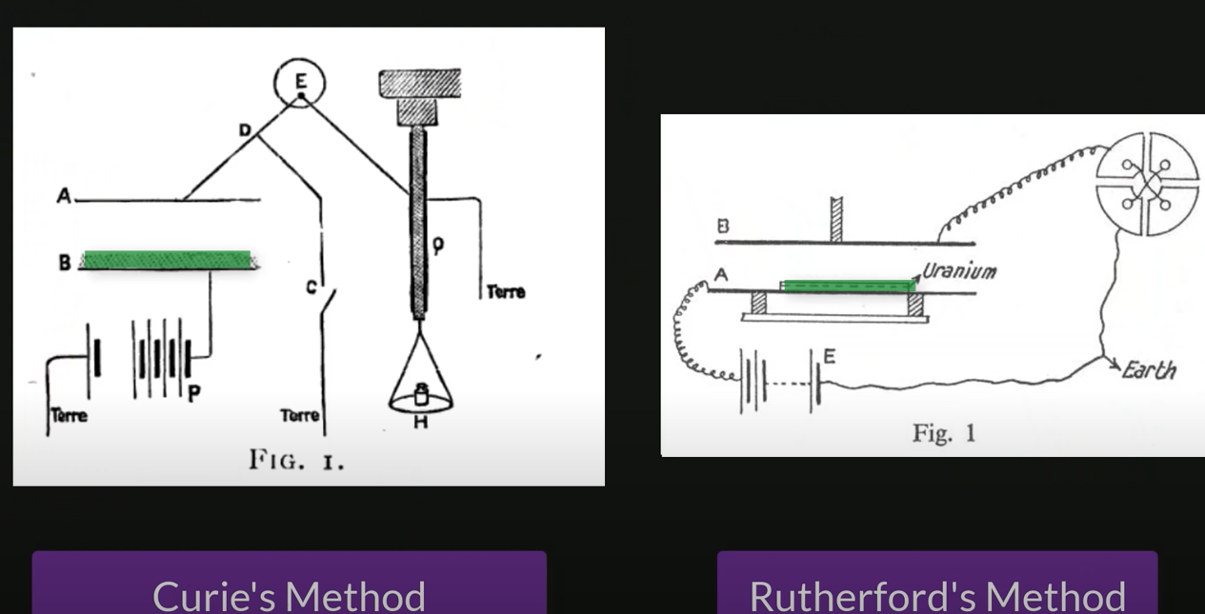
Rutherford Thinks to Try the Effect of These Uranium Rays on Gas instead of X rays

Slide 18
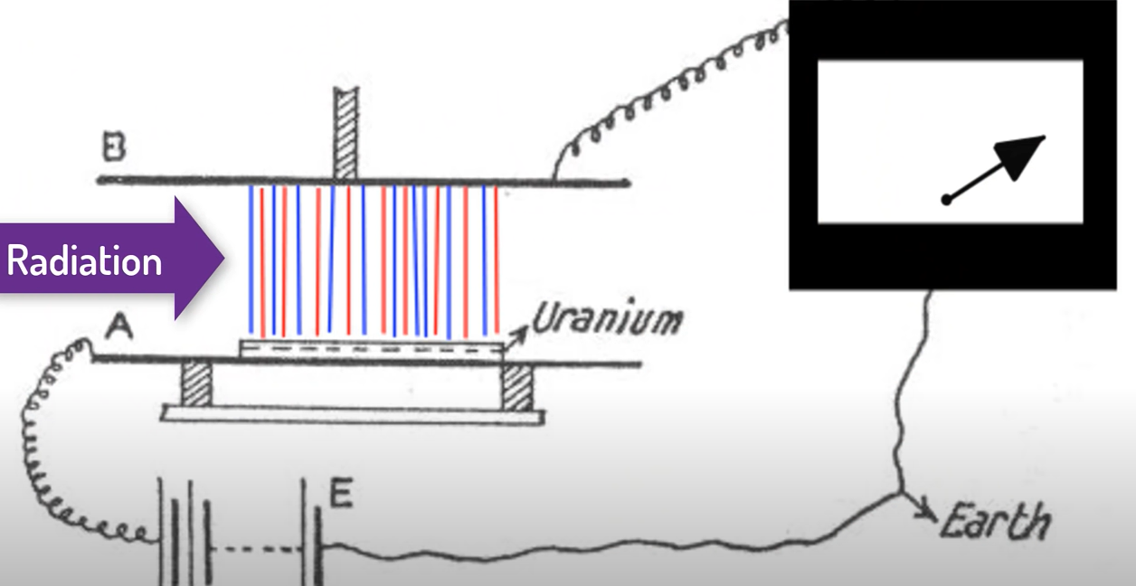

Slide 19
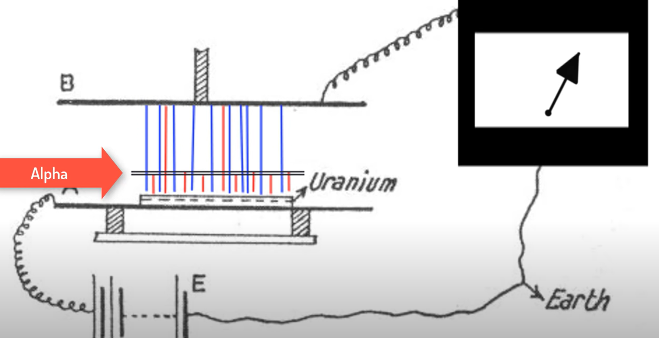

Slide 20
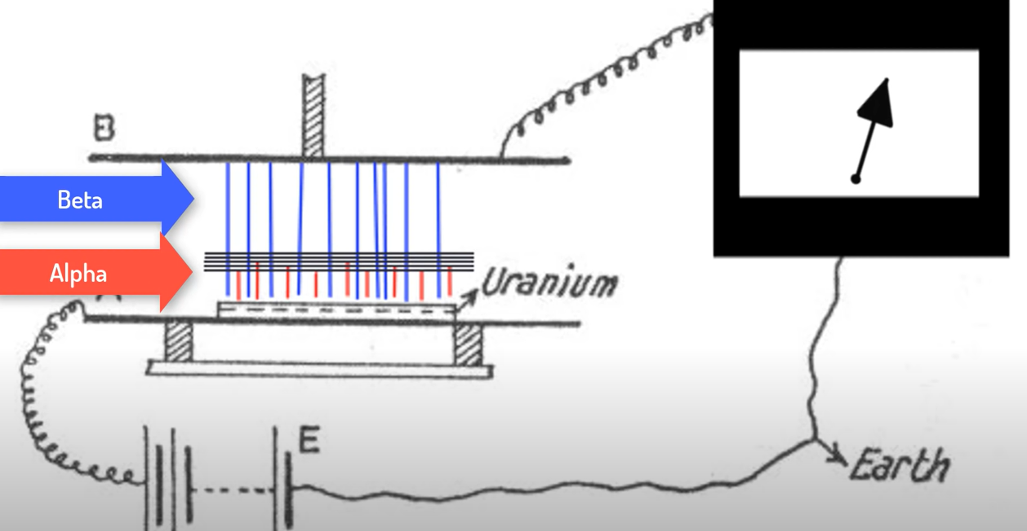

Slide 21
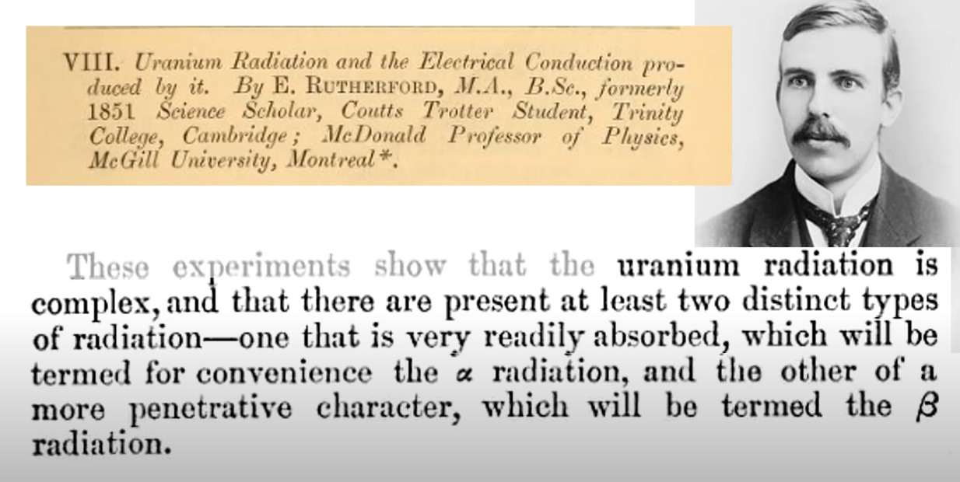

Slide 22
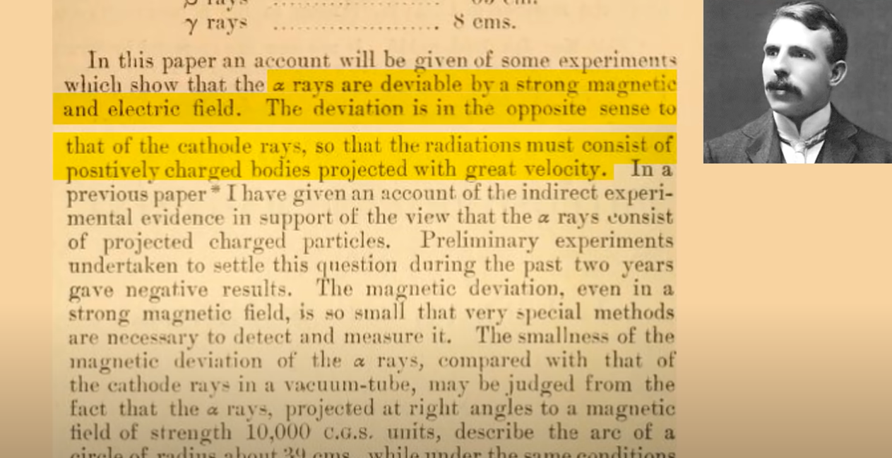

Slide 23
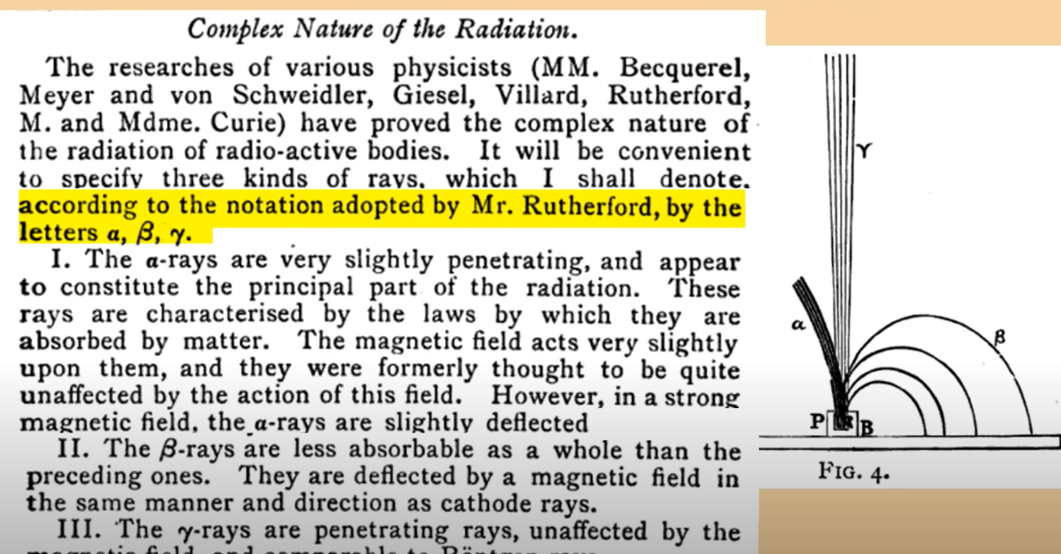

Slide 24
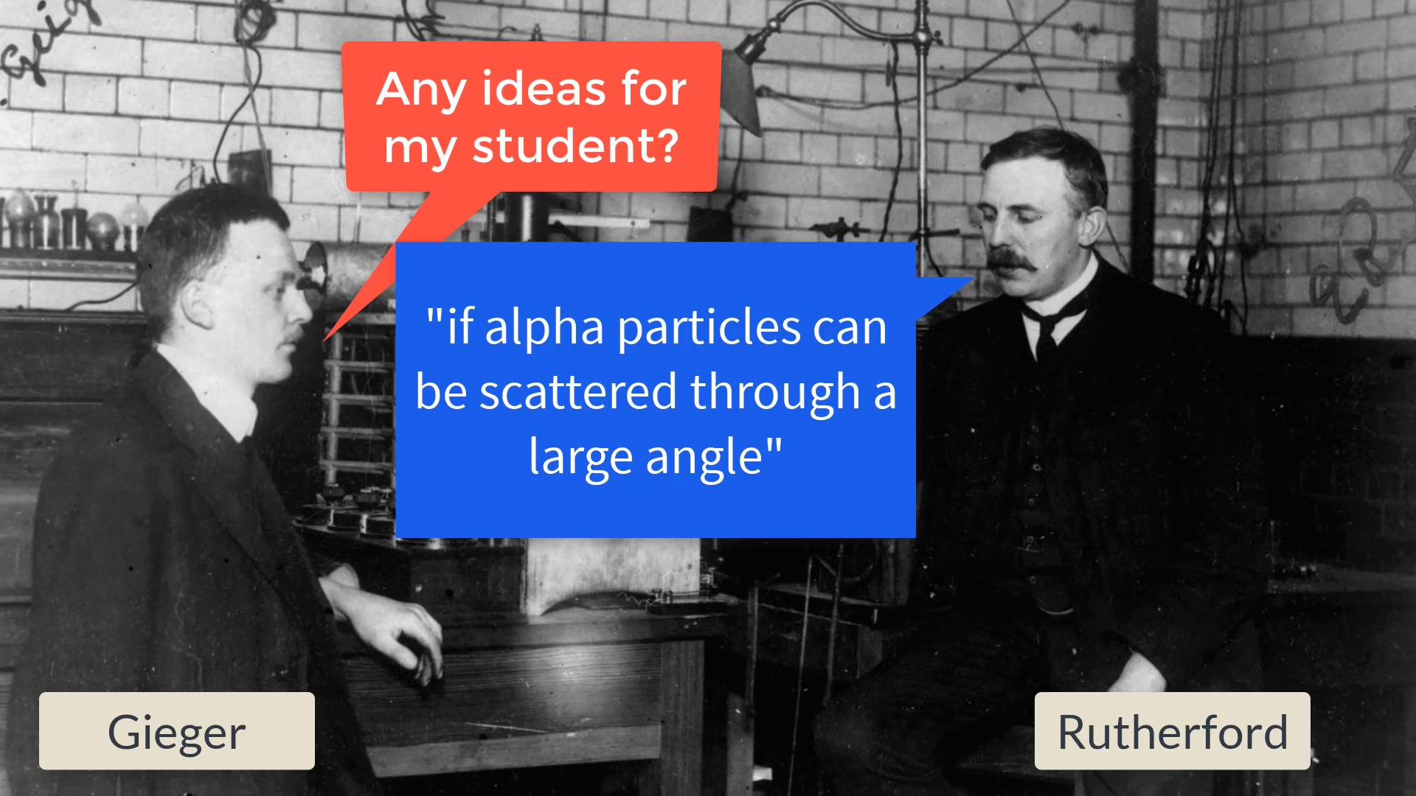

Slide 25
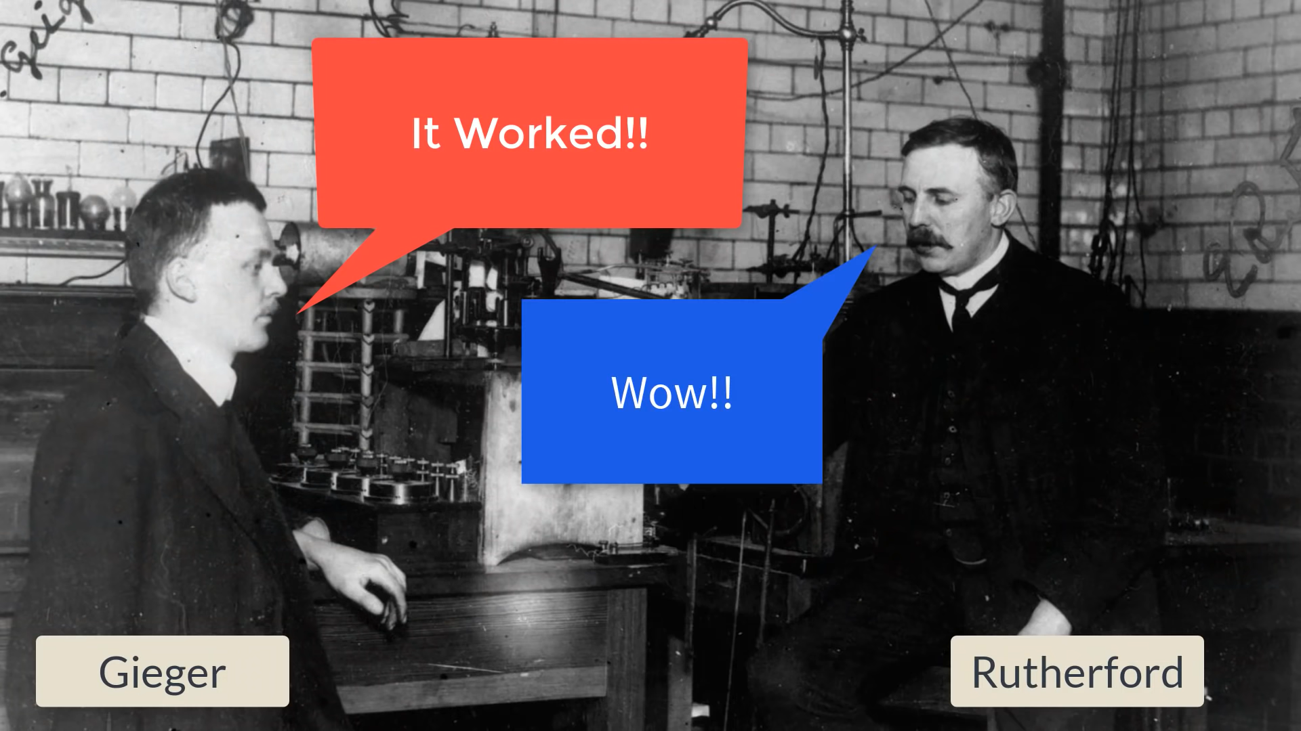

Slide 26
“Like Shooting a Bullet on A tissue Paper and Imagine that It reflects back from the Tissue and Hits you!”

Slide 27
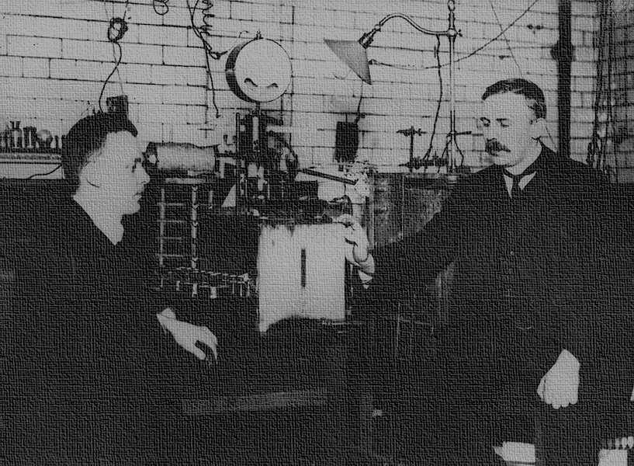
Chapter 3 The Legendary Gold Foil Experiment
Tirth Thesiya

Slide 28
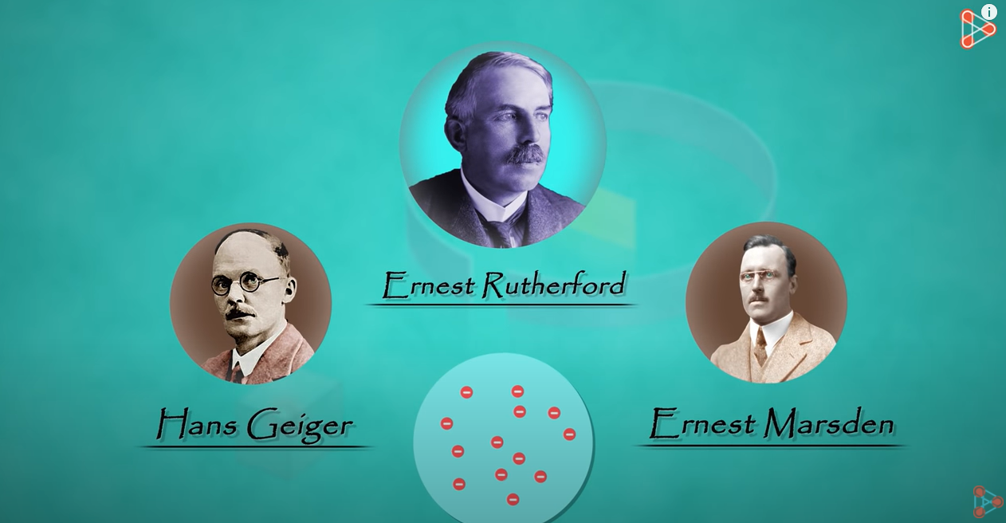

Slide 29
Rutherford’s gold foil experiment
In 1911, Rutherford and coworkers Hans Geiger and Ernest Marsden initiated a series of groundbreaking experiments that would completely change the accepted model of the atom.
They bombarded very thin sheets of gold foil with fast moving alpha particles.
Alpha particles, a type of natural radioactive particle, are positively charged particles with a mass about four times that of a hydrogen atom.

Slide 30
Why this experiment was conducted
According to the accepted atomic model of J.J.Thomson , in which an atom's mass and charge are uniformly distributed throughout the atom, the scientists expected that all of the alpha particles would pass through the gold foil with only a slight deflection or none at all.

Slide 31
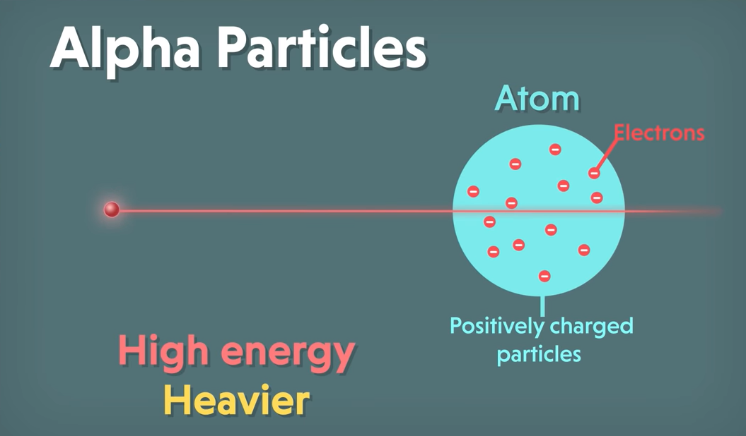

Slide 32
Expected Result
According to the accepted atomic model of J.J. Thomson, in which an atom's mass and charge are uniformly distributed throughout the atom, the scientists expected that all of the alpha particles would pass through the gold foil with only a slight deflection or none at all.

Slide 33
Observations
Most of the Alpha particles that bombarded the gold fell passed through without any deflection that shows that the nucleus is made up of a large empty space.
Few of the Alpha particles that bombarded against the gold foil experienced a very minor deflection that shows that there is a presence of a counter positive charge.
Still, some of the Alpha particles that bombarded against the gold foil deflected to a larger angle and some of them even bounced back showing that the positive charge is concentrated in a very small volume and its distribution is non-uniform.
All the above points show that the volume occupied by positively charged particles in an atom is very small as compared to the total volume of the atom.

Slide 34
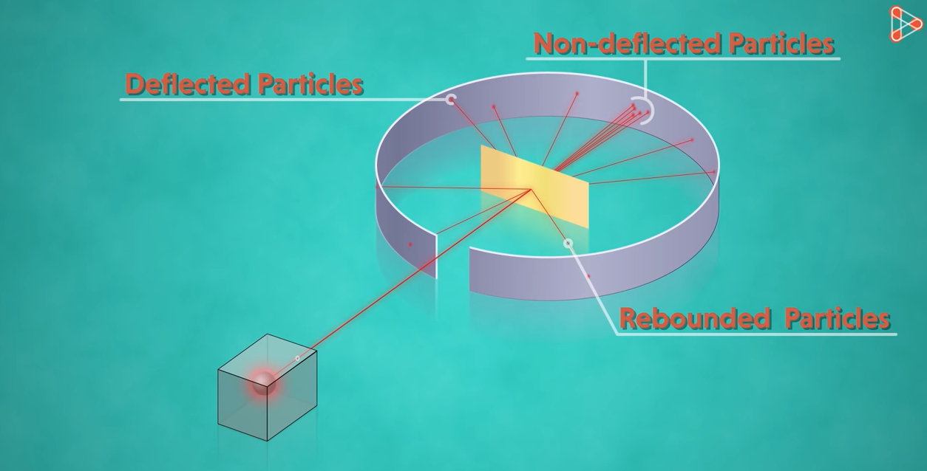

Slide 35

Explaining the Results
Rutherford needed to come up with an entirely new model of the atom in order to explain his results. Because the vast majority of the alpha particles had passed through the gold, he reasoned that most of the atom was empty space. In contrast, the particles that were highly deflected must have experienced a tremendously powerful force within the atom.
He concluded that all of the positive charge and the majority of the mass of the atom must be concentrated in a very small space in the atom's interior, which he called the nucleus. The nucleus is the tiny, dense, central core of the atom and is composed of protons and neutrons.

Slide 36
Drawbacks of this model
This atomic model failed to explain the stability of atoms.
According to the model, electrons revolve around the positively charged nucleus. It's not possible for the long run as we know atoms are stable while any particle in a circular orbit would undergo acceleration. During acceleration charged particles would radiate energy. Revolving electrons will lose energy and finally fall into the nucleus.
This model of the atom also failed to explain the existence of definite lines in the hydrogen spectrum.

Slide 37

Video of the Experiment

Slide 38
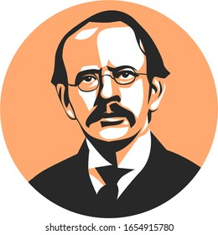
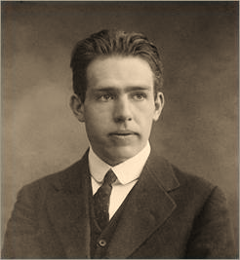
Chapter 4. Mentors and Notable Students
Pranaav Suratwala

Slide 39
JJ Thomson
After studying with J. J. Thomson at the Cavendish Laboratory at Cambridge University, Rutherford became a professor and chair of the Physics Department at McGill University in Montreal, Canada.
Sir Joseph John Thomson was a British physicist and Nobel Laureate in Physics, credited with the discovery of the electron, the first subatomic particle to be discovered and also credited with the discovery of Isotopes.

Slide 40
His Students
James Chadwick
John Cockcroft
Ernest Walton
Neils Bohr
Otto Hahn

Slide 41
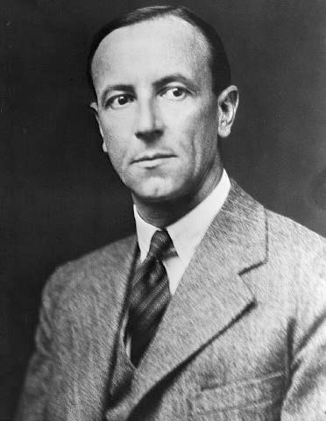
James Chadwick
James Chadwick as we know who helped discovered proton and theorized about existence of protons was a notable student of Ernest Rutherford.

Slide 42
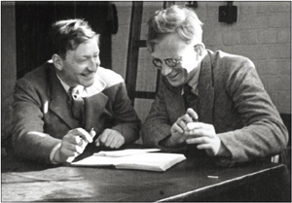
John Cockcroft
Rutherford's speech touched on the 1932 work of his students John Cockcroft and Ernest Walton in "splitting" lithium into alpha particles by bombardment with protons from a particle accelerator they had constructed.

Slide 43
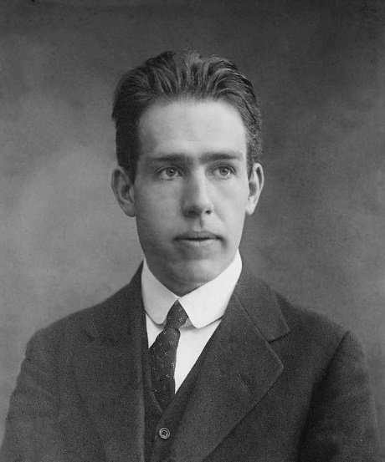
Neils Bohr
Rutherford had an enormous influence on the field of nuclear physics and mentored many future Nobel Prize winners and prominent scientists, including Niels Bohr and Otto Hahn.
Bohr was the first to discover that electrons travel in separate orbits around the nucleus and that the number of electrons in the outer orbit determines the properties of an element. The chemical element bohrium (Bh), No. 107 on the periodic table of elements, is named for him.

Slide 44
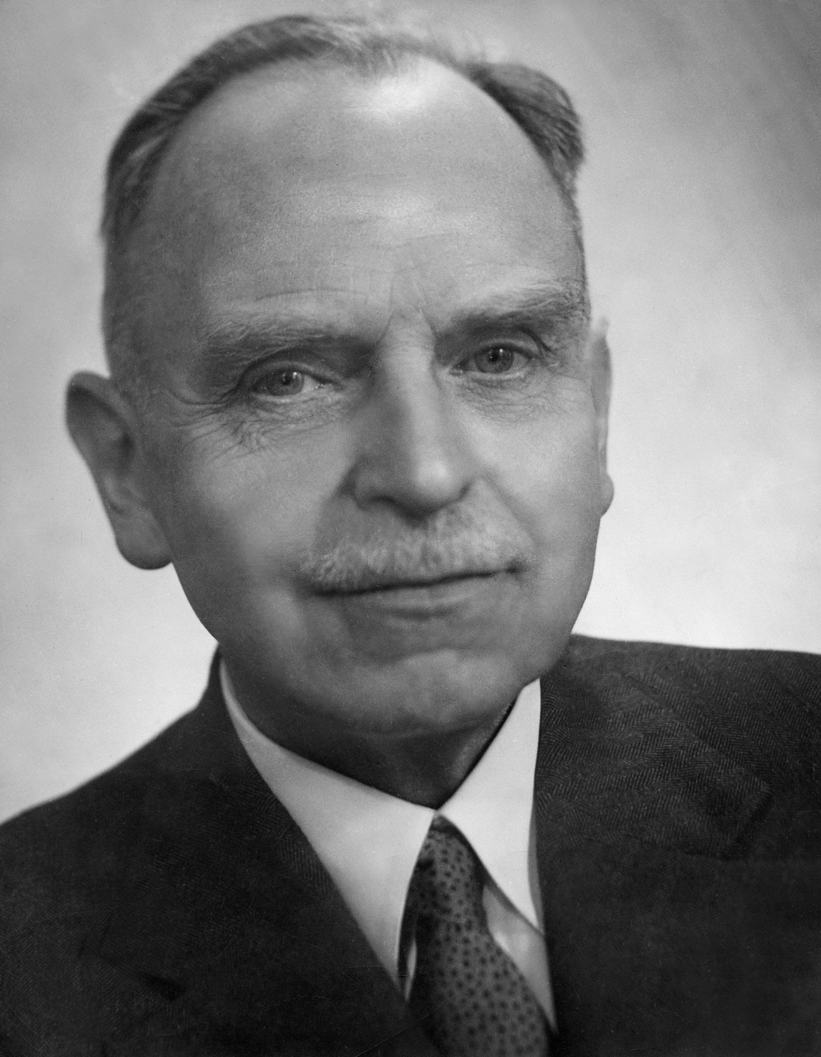
Otto Hahn
Hahn discovered the fission of uranium and thorium in medium heavy atomic nuclei and his first work on these subjects appeared on 6th January and 10th February, 1939. He also discovered Radioactive Elements

Slide 45
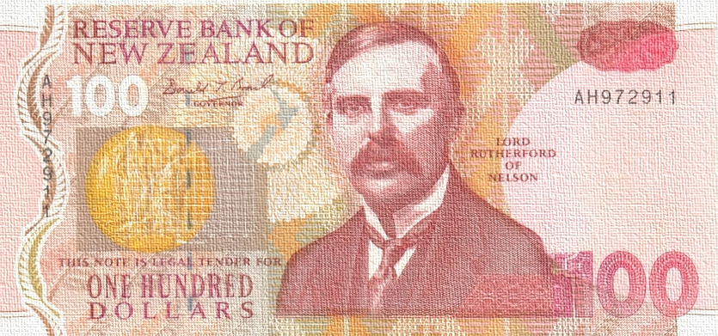
Chapter 5. Chemical Accomplishments & Conclusion
Devanshu Surana

Slide 46
Awards
AwardsRumford Medal (1904)
Nobel Prize in Chemistry (1908)
Barnard Medal (1910)
Elliott Cresson Medal (1910)
Associate of NSOS(1911)
Matteucci Medal (1913)
Hector Memorial Medal (1916)
Dalton Medal (1919)
Copley Medal (1922)
Franklin Medal (1924)
Albert Medal (1928)
Faraday Medal (1930)
Wilhelm Exner Medal (1936)
Faraday Lectureship Prize (1936)

Slide 47
Chemical Accomplishments
A consummate experimentalist, Rutherford (1871–1937) was responsible for a remarkable series of discoveries in the fields of radioactivity and nuclear physics.
He discovered alpha and beta rays, set forth the laws of radioactive decay, and identified alpha particles as helium nuclei.
He discovered the Half Life of Radiation
Most important, he postulated the nuclear structure of the atom
Published more than 160 Papers in 30 Years

Slide 48

Prepared By :
Krishnaraj PT - Presentation, Alpha and Beta Rays
Tirth Thesiya –
Gold Foil Experiment
Pranaav Suratwala –
Notable Mentors and Students
Devanshu Surana –
Chemical Accomplishments and Awards
Vedant Shirode – Introduction

Slide 49

Thanks for Listening!

